Slide 1
Network & Topologies
AYHAM ASHRAF

Slide 2

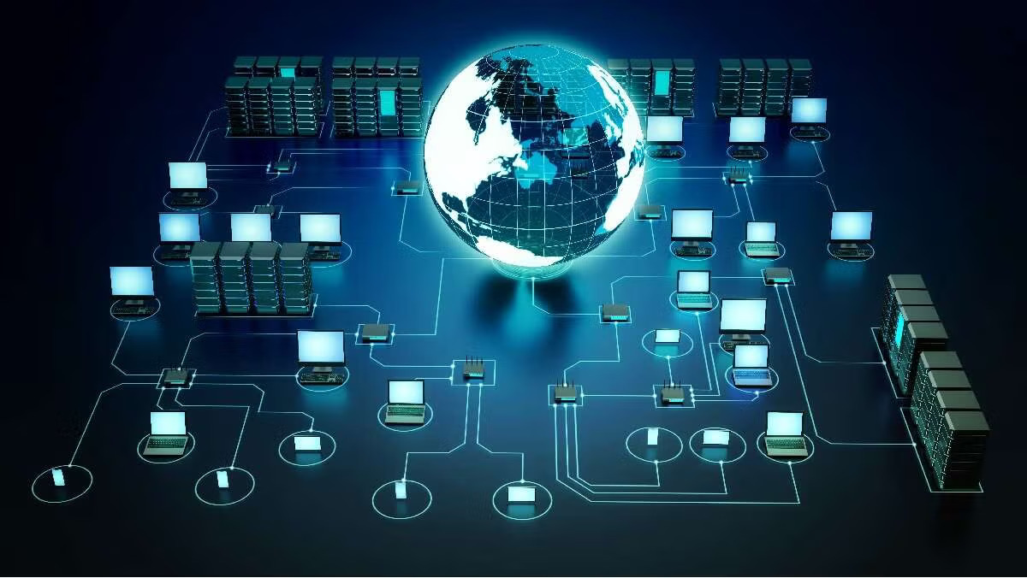
Network Topology
The arrangement or layout of different elements

Slide 3
Think of it like this:
Arranging seats in a classroom. The way students are positioned affects how easily they can communicate with each other. Similarly, network topology describes how devices are arranged and connected, affecting the efficiency and reliability of communication within a network.

Slide 4
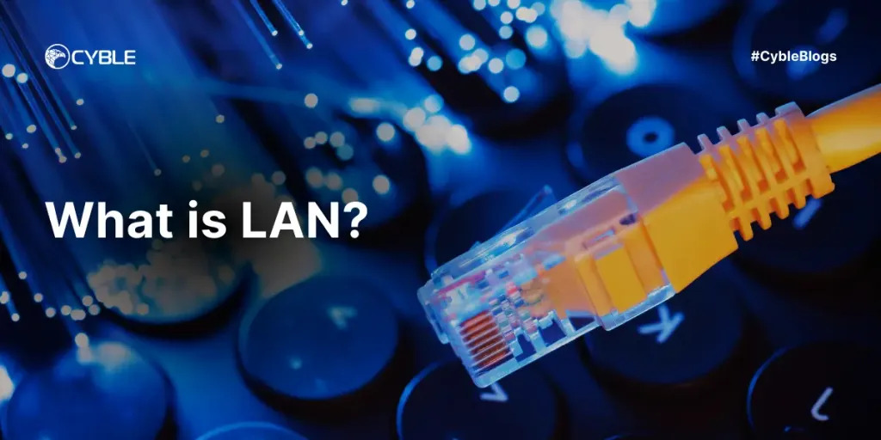
LAN
Stands for: Local Area Network.
A network that connects computers within a limited area.

Slide 5
Mostly used in:
Local areas like houses, schools, or office buildings.

Slide 6
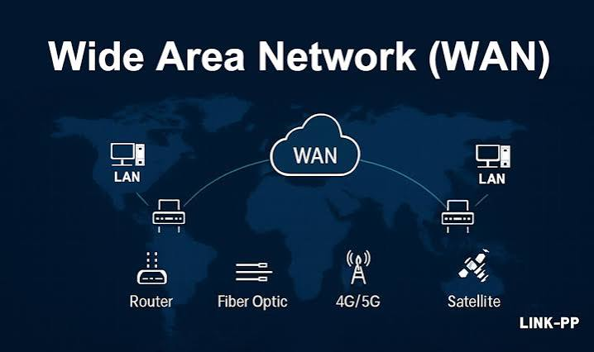
WAN
Wide Area Network;
A telecommunications network that extends over a large area.

Slide 7
It's large area:
Extends over a large geographical area for the primary purpose of computer networking.

Slide 8
MAN
Metropolitan Area Network;
A network that covers a larger geographical area than LAN but is smaller than a WAN

Slide 9
VPN
Virtual Private Network;
A technology that creates a safe and encrypted connection over a less secure network, such as the internet.

Slide 10
Uses:
Often used for adding a virtual location to the device to avoid apps from detecting the real location.

Slide 11
Router
A device which forwards data packets between computer networks, creating an overlay internetwork.

Slide 12
Switch
A device in a network that connects other devices together using packets switching to forward data to its destination.

Slide 13
Hub
A basic networking device that connects multiple computer in a network, forwarding data to all connected devices.

Slide 14
Server
A computer or system that provides resources, data, services, or programs to other computers, known as clients, over a network.

Slide 15
Protocol
A set of rules governing the exchange or transmission of data between devices.

Slide 16
Ethernet
A system for connecting computers in a LAN using physical cables.

Slide 17
Wi-Fi
A technology that allows electronic devices to connect to a wireless LAN network, mainly using the 2.4GHz and 5GHz radio bands.

Slide 18
IP Address
A unique string of numbers separated by periods that identifies each computer using the internet Protocol to communicate over a network.

Slide 19
Subnet Mask
A number that identifies a range of IP addresses available within a network.

Slide 20
Gateway
A network point that acts as an entrance to another network often used to connect different networks, such as a local network to the internet.

Slide 21
Firewall
A network security system that monitors and controls incoming and outgoing network traffic based on the predetermined security rules.

Slide 22
Bandwidth
The maximum rate of data transfer across a given path, measured in bits per second (bps)

Slide 23
Latency
The time it takes for a data packet to travel from a source to destination, of measured in milliseconds (ms).

Slide 24
DNS
A system that translates domain names into IP addresses that computers can understand.

